Slide 1
Google Developer Student Clubs
November 3 - November 8
6:45 - 8 PM
Artificial Intelligence and Machine Learning
Workshop hosted by - Daksh Oza

Slide 2
Google
Developer Student Clubs
Contents
Introduction to AI/ML
Showing end project
Explanation on supervised learning and unsupervised learning
Single Linear Regression
Multiple Linear Regression
Model Performances and improvement
Artificial Intelligence and Machine Learning

Slide 3
BASICS
Artificial Intelligence and Machine Learning
Field of study that gives computers the ability to learn without being explicitly programmed
AI/ML is applicable to any field and allows for enhancement of efficiency and accuracy
More a model trains, better it gets
The boom in this field is a direct result of the increase of availability of all sorts of data

Slide 4
BASICS
Artificial Intelligence And Machine Learning
TYPES OF LEARNING
Reinforcement Learning
Recommender Systems
Learning methods
Supervised Learning
Unsupervised Learning

Slide 5
BASICS
Artificial Intelligence And Machine Learning
SUPERVISED LEARNING
Supervised Learning
Regression
Classification
learns from given “right answers”
X Y
X (input) | Y (target/output)
House Data | Cost of House
Email | Spam or Not?
Image | Cat or Dog?

Slide 6
BASICS
Artificial Intelligence And Machine Learning
UNSUPERVISED LEARNING
There is no given target or output value, which means we only have inputs.
It is used to find a pattern or structure in the data.
The model doesn’t actually know what the data represents, but focuses on finding similarities amongst the data.
Algorithms:
Clustering: groups similar data together
Anomaly : finds unusual data points
Dimensionality Reduction: compress data using fewer numbers

Slide 7
LINEAR REGRESSION
Artificial Intelligence And Machine Learning
TERMINOLOGY
Variable | What they represent
Training set | Data set used to train models
x | Standard notation for “input variable” or feature
y | Standard notation for “output variable” or “target variable”
m | Number of training examples
(x, y) | Single training example
(x(i), y(i)) | ith training example

Slide 8
LINEAR REGRESSION
Artificial Intelligence And Machine Learning
LETS UNDERSTAND WITH AN EXAMPLE
Student Performance | Student Performance
Index (i) | Previous score x (input) | Predicted Score y (output)
1 | 99 | 91
2 | 51 | 45
Training
set
Here,
m = 2
((x(1), y(1)) = (99, 91)
((x(2), y(2)) = (51, 45)

Slide 9
LINEAR REGRESSION
Artificial Intelligence And Machine Learning
UNDERSTANDING A LEARNING FUNCTION
Training set
Learning Algorithm
input
feature
prediction or estimated y
x
f(x)
y
Model (function)

Slide 10
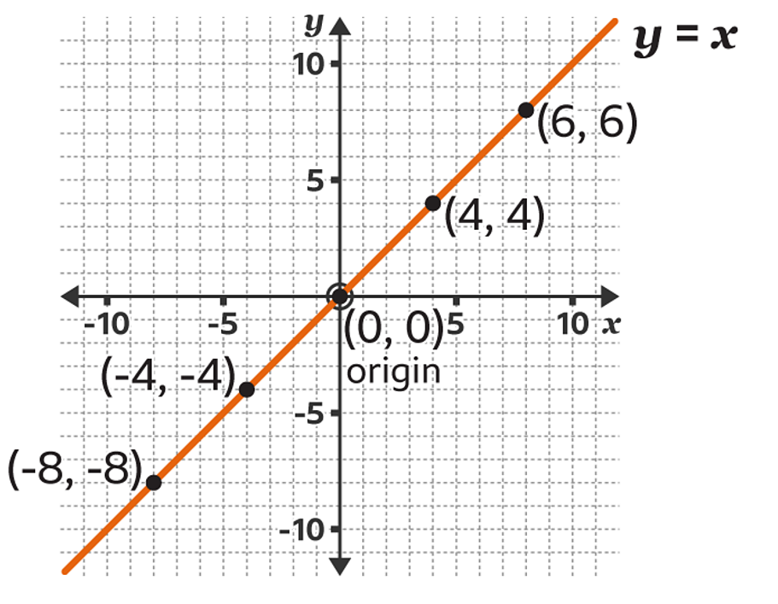
LINEAR REGRESSION
Artificial Intelligence And Machine Learning
LETS UNDERSTAND THE FUNCTION OF A LINE
The equation of a line is: y=mx + c
The example on the right has a line with the equation y = x
So,
if x = 4, y = 4
if x = 6, y = 6
if x = -4, y = -4
Lets compare:
y = mx + c - (1)
y = x - (2)
From these, we can conclude that
in eq (2), m = 1 and c = 0

Slide 11
LINEAR REGRESSION
Artificial Intelligence And Machine Learning
LINEAR REGRESSION
m and c are called parameters that directly affect the output y
In AI/ML, we use the terms weights (w) and bias (b) instead of m and c
Linear regression is essentially finding optimal values for w and b so that the function f(x) = wx + b returns an accurate value.

